Slide 1
PS> .\Install-SqlServer.ps1 "Automating your SQL Server install"
Andy Mallon

Slide 2
Andy Mallon
Working with SQL Server since 2003 and SQL Server 2000
Background in Tech Support
Managed databases in many industries
Lazy
Impatient
Healthcare
Finance
E-Commerce
Non-Profit

Slide 3



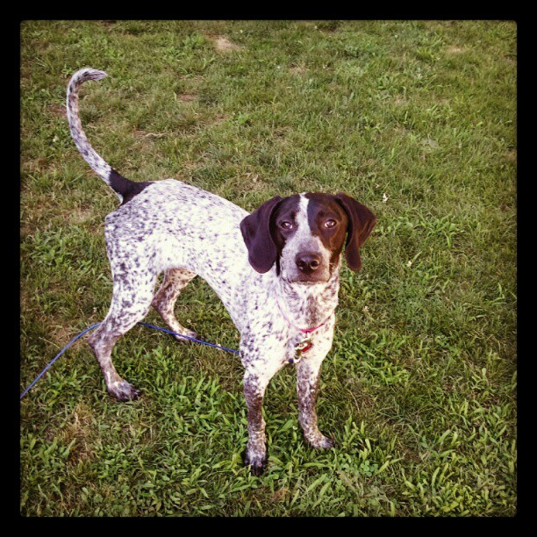


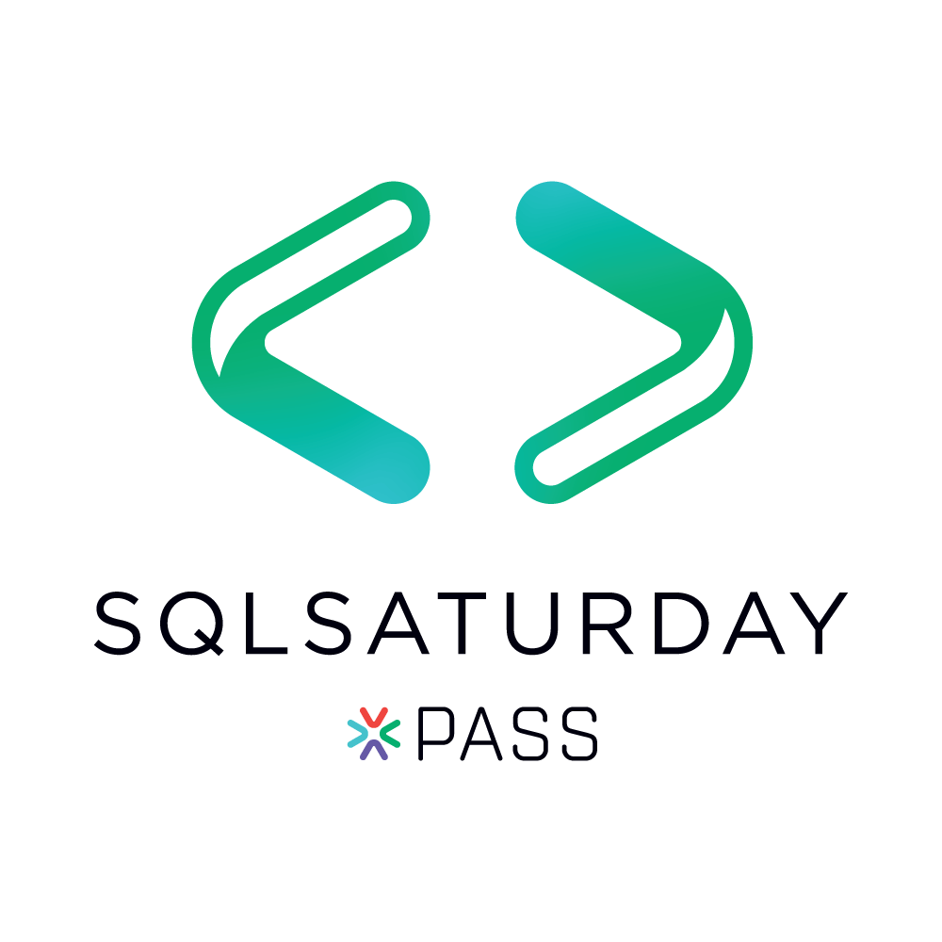

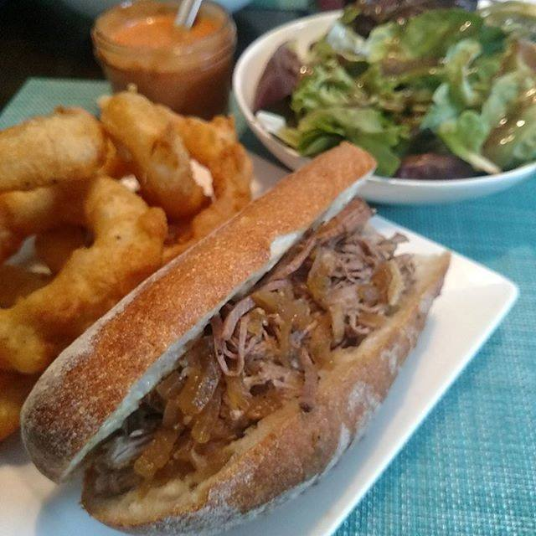



Notes:
Some of the things I love most in life– My husband, my pups, my food (I love to cook), and my city.

Slide 4


Community Ambassador

Slide 5




Contact Info
andy@am2.co
@AMtwo
www.am2.co
linkedin.com/in/AMtwo
@AMtwo
www.am2.co
andy@am2.co

Slide 6

Who uses Twitter?
Where the SQL Community hangs out
#sqlhelp
Free real-time help
Notes:
Who doesn’t want free advice from Brent Ozar or Aaron Bertrand?

Slide 7

Who uses Slack?
If nvarchar(140) isn’t enough
#sqlhelp #powershellhelp #ssrshelp
http://www.dbatools.io/slack for details
Notes:
Who doesn’t want free advice from Brent Ozar or Aaron Bertrand?

Slide 8

Session Feedback
Tell me what you don’t like
Tell me what can be better
Tell me what you like

Slide 9

I'm also gonna need you to go ahead and silence your cell phones
Yea…….You apparently didn’t put one of the new coversheets on your TPS reports.

Slide 10
What we’ll cover
Why automation is important
Why standard builds are important
Why automated installs are important
Using the GUI installer to get started
Perform an install in one line of PowerShell

Slide 11
Before I start…
Who has used PowerShell?
How comfortable are you with PowerShell?
Who has a standard build for SQL Server?

Slide 12
Why is automation important?

Slide 13

I’m lazy
Boring tasks are boring
Repetitive tasks are boring
I want to work smarter, not harder

Slide 14

I’m busy
I have a lot of work to do
I like to relax on nights & weekends
I want to be bored

Slide 15
Why have a standard build?

Slide 16
Consistency
Easier to troubleshoot problems
Easier to predict behavior

Slide 17

The DBA is the Sheriff
We’re held accountable for the environment
Just because you can doesn’t mean you should

Slide 18
Standard Builds
The default install
Everyone uses it unless they can’t
SLAs are based on this configuration
Collation
Latin1_General_CI_AI
MAXDOP
CPUs/NUMA, 8 max
Installed Features
Full-Text Indexing

Slide 19
Exception Builds
Supported alternatives
You’ve determined potential pitfalls
SLAs are usually lower
Collation
3rd party apps
MAXDOP
SharePoint ☹
Installed Features
If an application requires it

Slide 20
Prohibited Builds
Scenarios that aren’t allowed in your environment
Security
Industry Regulation
Lack of knowledge
xp_cmdshell
Cross-database ownership chaining
Old versions
Availability Groups

Slide 21
Why have automated installs?

Slide 22
Productivity
Do more faster
Less time on routine tasks
More time on unique tasks

Slide 23
Save time & money
Save on labor costs
Mitigate labor shortages
Increase your value to your employer

Slide 24
Improve quality
Humans make mistakes
Automation makes the same mistake repeatedly
Fixing automation fixes the error forever

Slide 25
Improve speed
Product releases are getting faster
Upgrades and new installs are more frequent
Faster results make happy customers

Slide 26
Standardization
Easier to identify problems
Easier to predict problems
Easier to prevent problems

Slide 27
SQL Install Automation

Slide 28
Install automation methods
ConfigurationFile.ini file
Setup.exe /param1 /param2
Both

Slide 29
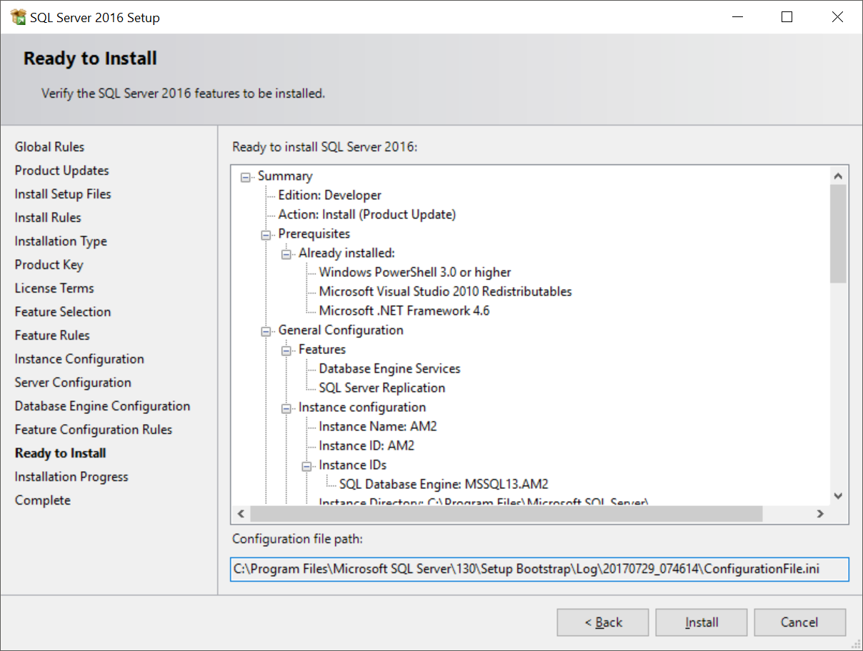
ConfigurationFile.ini

Slide 30
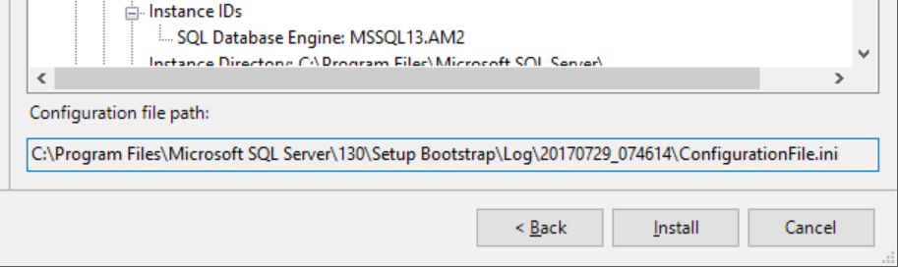
ConfigurationFile.ini

Slide 31
Demo

Slide 32
Questions?

